Slide 1
In Search of True PAC
AIRLab
Presented by:
Mohammad Hossein Shafieizadegan

Slide 2
20
24
Table of Contents
1
2
3
4
Generating synthesized signal
Rid-rihaczek
Permutation test
CWT
01

Slide 3
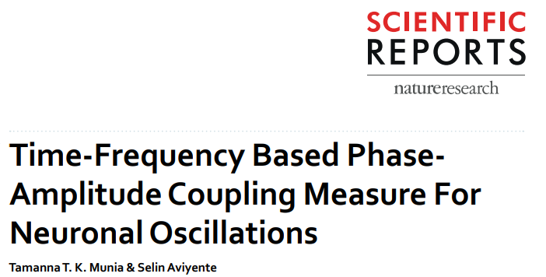
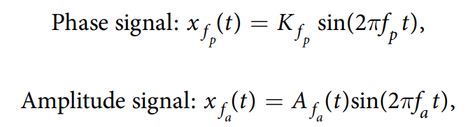
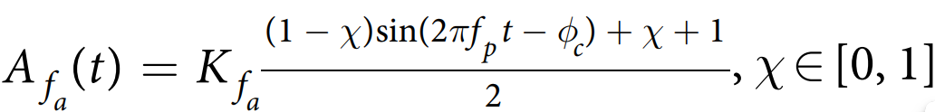
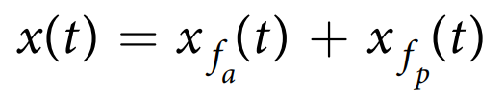
20
24
Synthesize the signal
Using proposed method at
02

Slide 4
20
24
Synthesize the signal
Signal consists of three sections
Random Gaussian noise
Coupled signal 1:
phase freq = 5
amplitude freq = 40
Coupled signal 2:
phase freq = 9
amplitude freq = 60
02

Slide 5
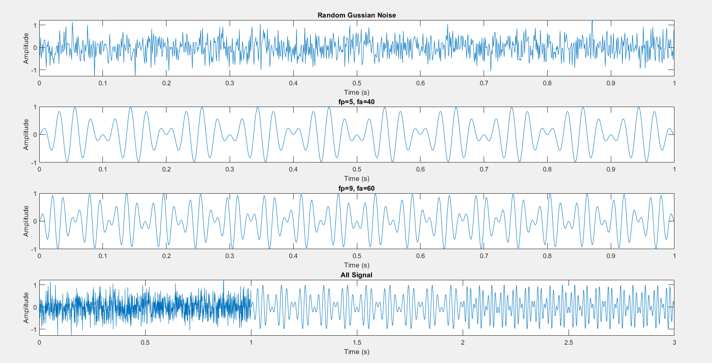
20
24
04

Slide 6
20
24
How to assess PAC?!
03
Generating Comodulograms
PAC dynamic
Statistical test:
Sample size: 1000
Population 1:
Coupled signals:
Random Phase freq in range: [4, 7]
Random Amp freq in range: [38, 42]
Population 2:
Coupled signals:
Random Phase freq in range: [8, 11]
Random Amp freq in range: [55, 65]
Null hypothesis:
PAC in range [4,8] and [35, 45] is higher for second population

Slide 7
20
24
Generating Comodulograms
PAC dynamic
Statistical test:
Sample size: 100
Population 1:
Coupled signals:
Random Phase freq in range: [4, 7]
Random Amp freq in range: [38, 42]
Population 2:
Coupled signals:
Random Phase freq in range: [8, 11]
Random Amp freq in range: [55, 65]
Null hypothesis:
PAC in range [4,8] and [35, 45] is higher for second population
How to protect innovation?!
03

Slide 8
20
24
Rid-rihaczek – Method 1
Old previously used function
Supposed to have implementation bug in the code
First Windowing the signal, then calculating tf-decomposition
06

Slide 9
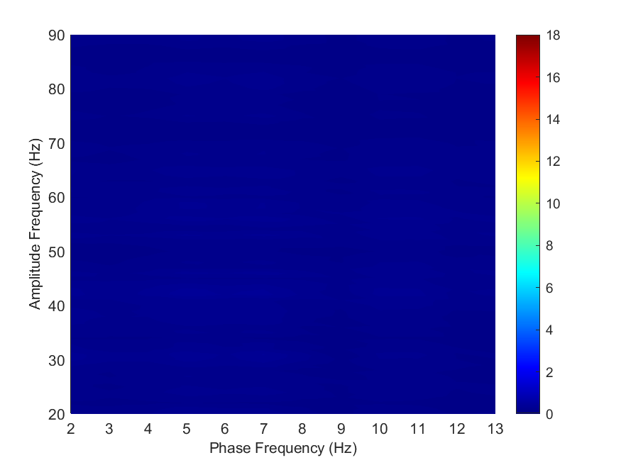
20
24
Comodulogram Results
Gaussian Noise
03

Slide 10
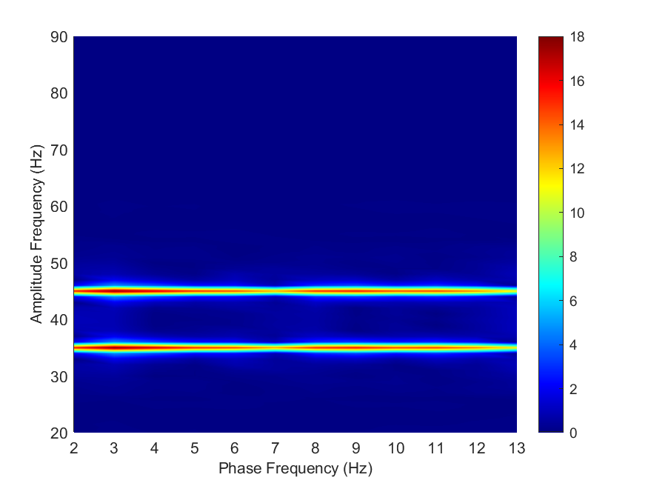
20
24
Comodulogram Results
Coupled signal 1:
phase freq = 5
amplitude freq = 40
03

Slide 11
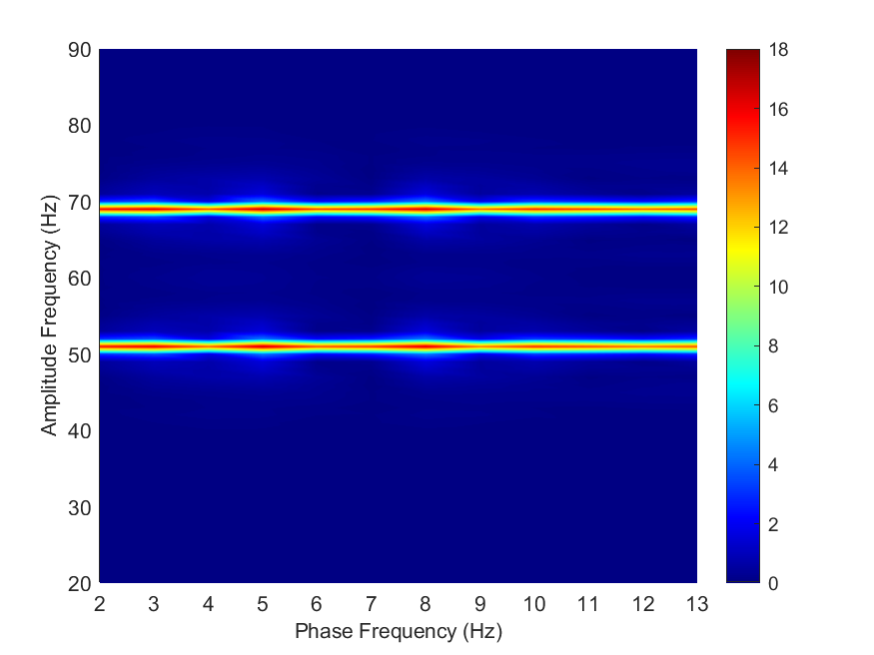
20
24
Comodulogram Results
Coupled signal 2:
phase freq = 9
amplitude freq = 60
03

Slide 12
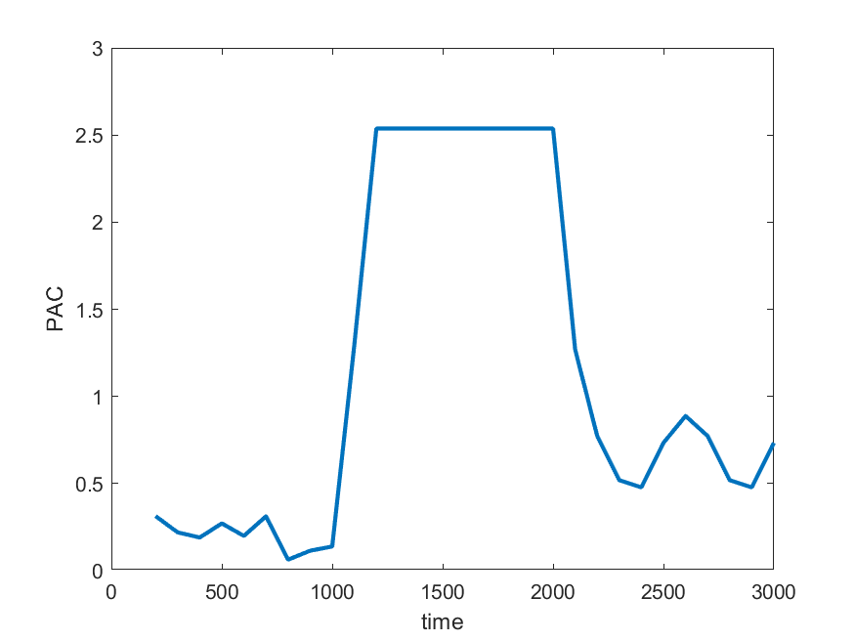
20
24
PAC dynamic
Statistical Analysis:
P-value =
2.0597e-11
03

Slide 13
20
24
Rid-rihaczek – Method 2
Old previously used function
Resolve the bug by adding `ifft` and `fft2`
First Windowing the signal, then calculating tf-decomposition
06

Slide 14
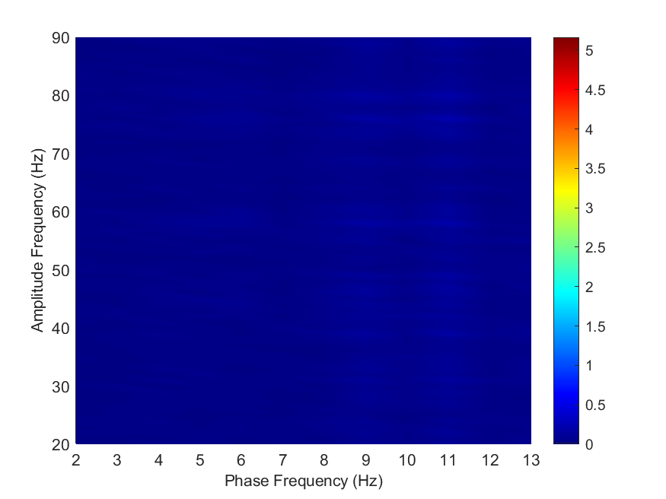
20
24
Comodulogram Results
Gaussian Noise
03

Slide 15
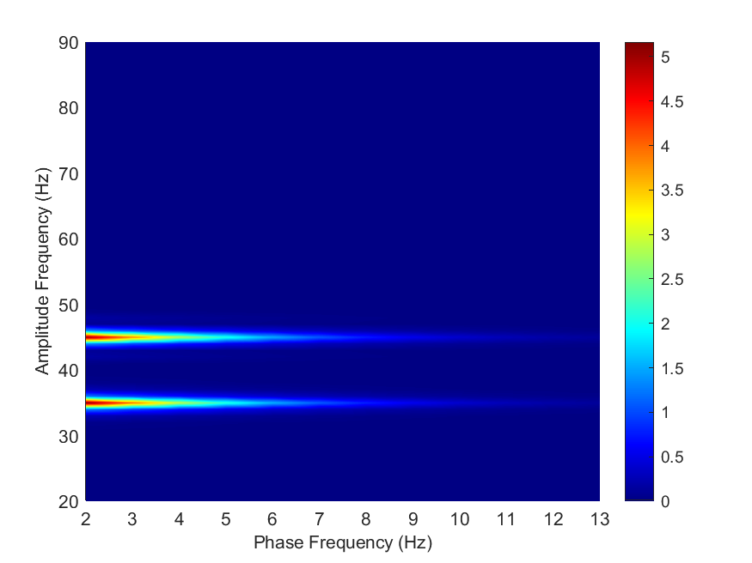
20
24
Comodulogram Results
Coupled signal 1:
phase freq = 5
amplitude freq = 40
03

Slide 16
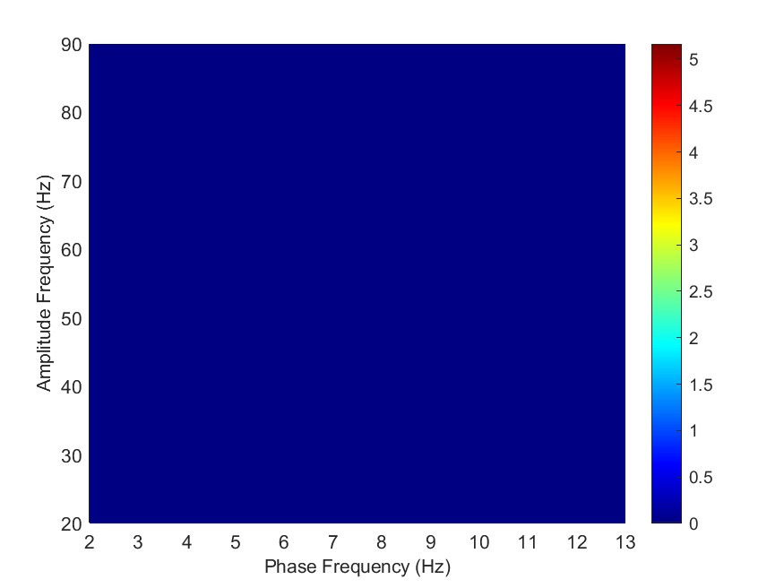
20
24
Comodulogram Results
Coupled signal 2:
phase freq = 9
amplitude freq = 60
03

Slide 17
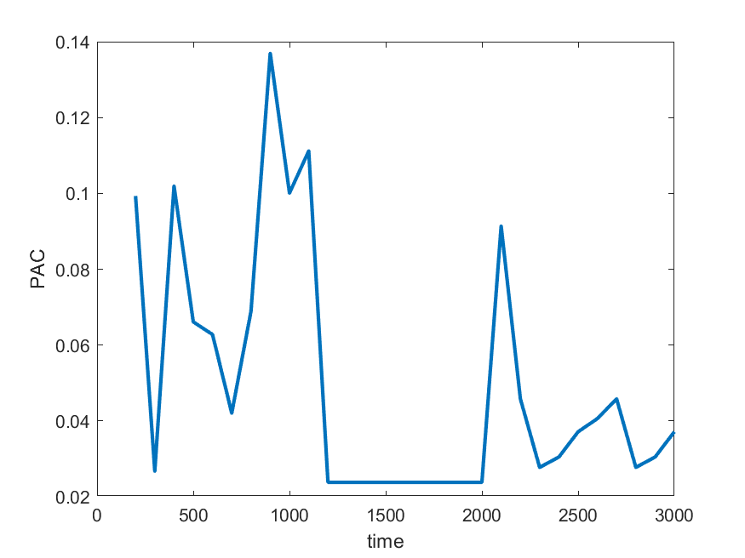
20
24
PAC dynamic
Statistical Analysis:
P-value =
6.0473e-05
03

Slide 18
20
24
Rid-rihaczek – Method 3
New function developed by Neuro Freq toolbox
Different faster implementation
First Windowing the signal, then calculating tf-decomposition
06

Slide 19
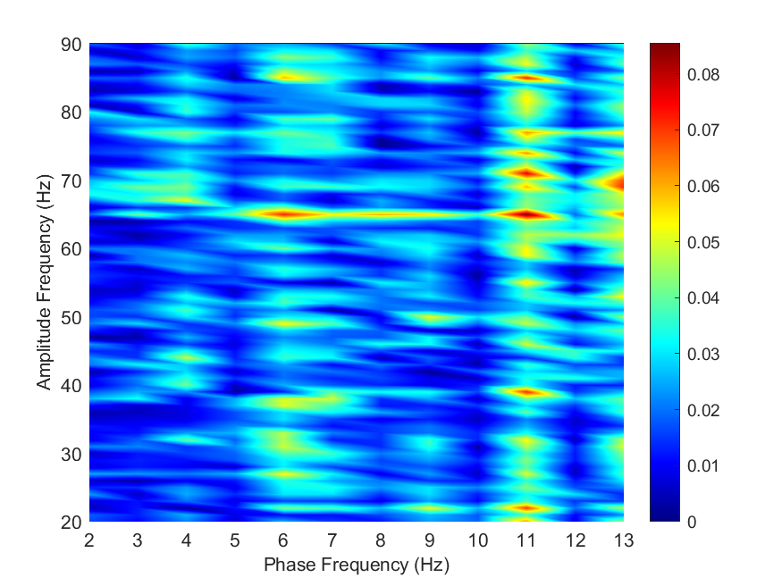
20
24
Comodulogram Results
Gaussian Noise
03

Slide 20
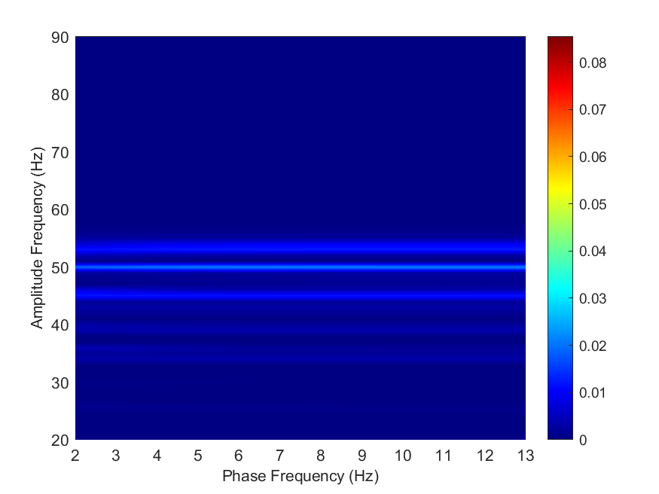
20
24
Comodulogram Results
Coupled signal 1:
phase freq = 5
amplitude freq = 40
03

Slide 21
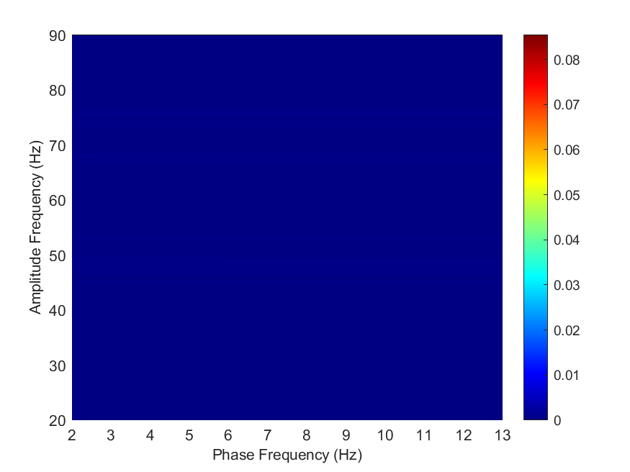
20
24
Comodulogram Results
Coupled signal 2:
phase freq = 9
amplitude freq = 60
03

Slide 22
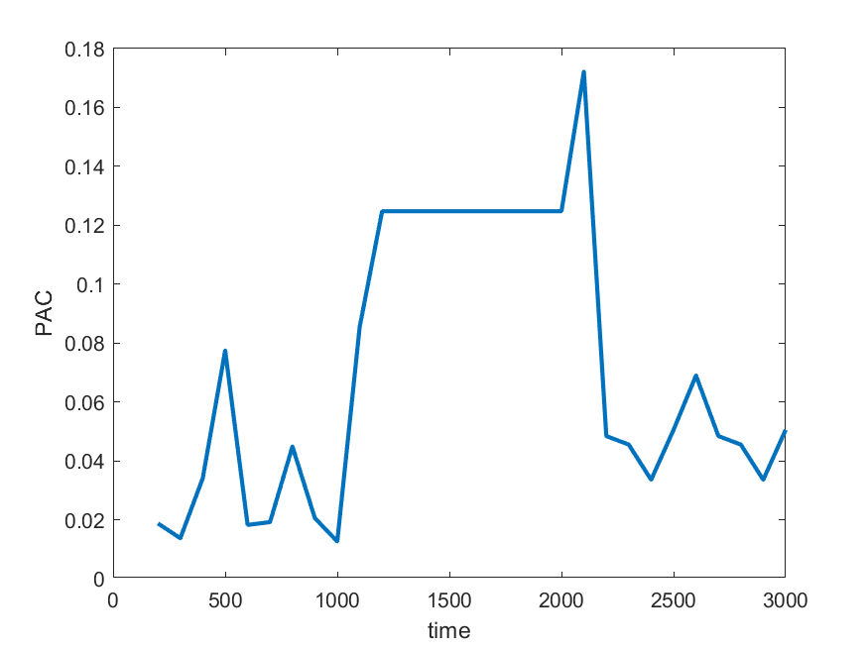
20
24
PAC dynamic
Statistical Analysis:
P-value =
2.2461e-06
03

Slide 23
20
24
CWT
CWT function by Neuro Freq toolbox
faster implementation
First calculating tf-decomposition, then Windowing the signal
06

Slide 24
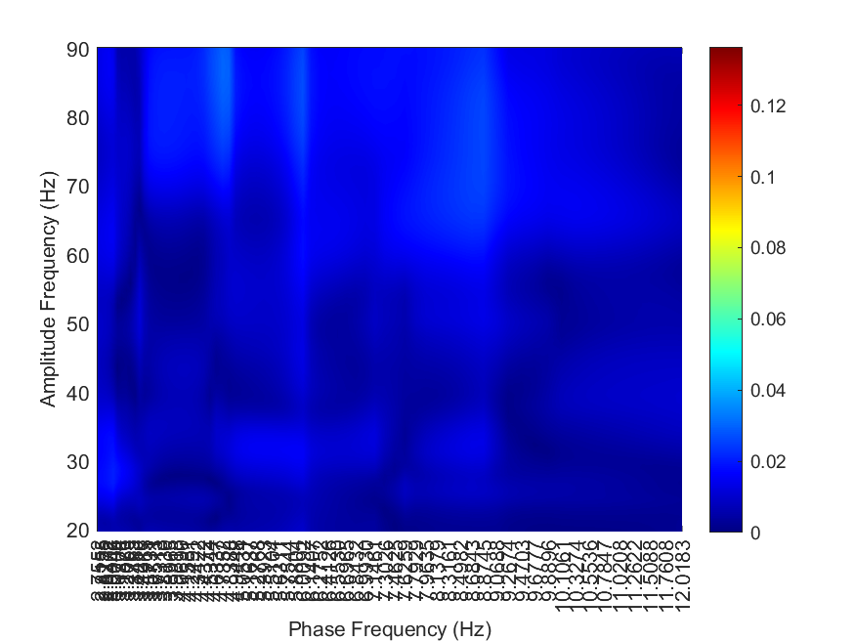
20
24
Comodulogram Results
Gaussian Noise
03

Slide 25
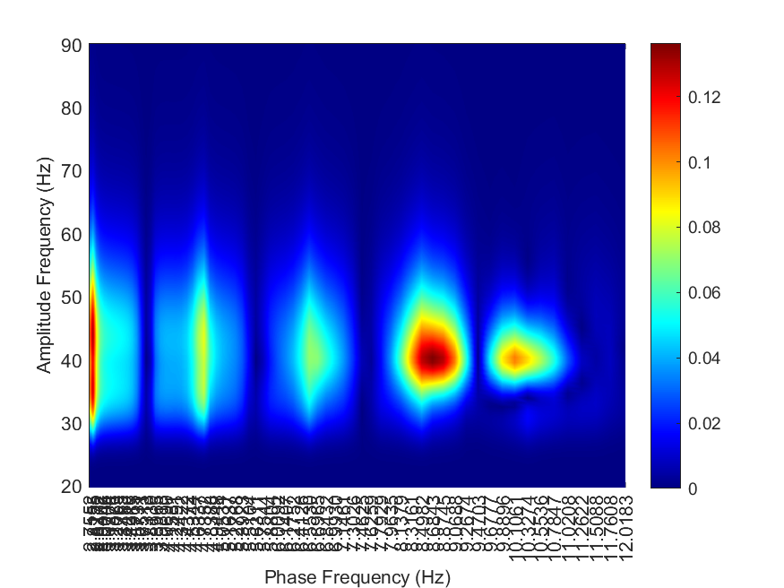
20
24
Comodulogram Results
Coupled signal 1:
phase freq = 5
amplitude freq = 40
03

Slide 26
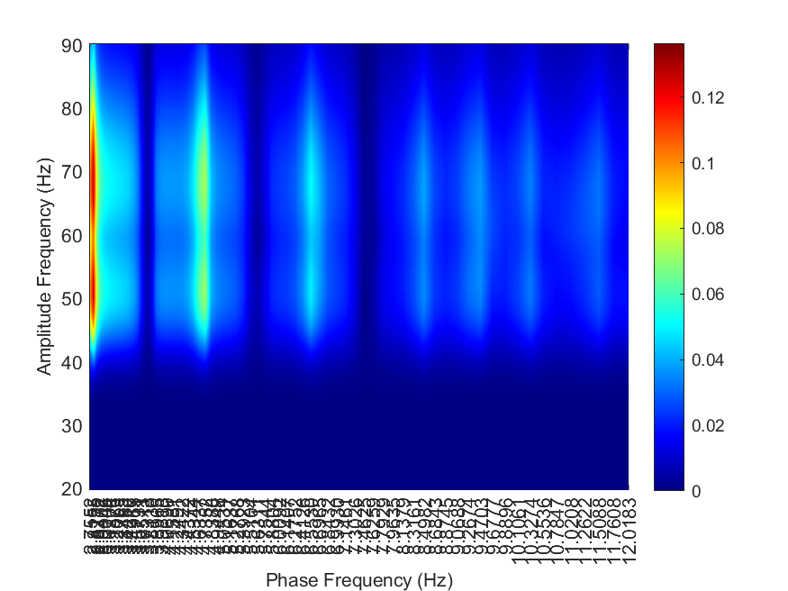
20
24
Comodulogram Results
Coupled signal 2:
phase freq = 9
amplitude freq = 60
03

Slide 27
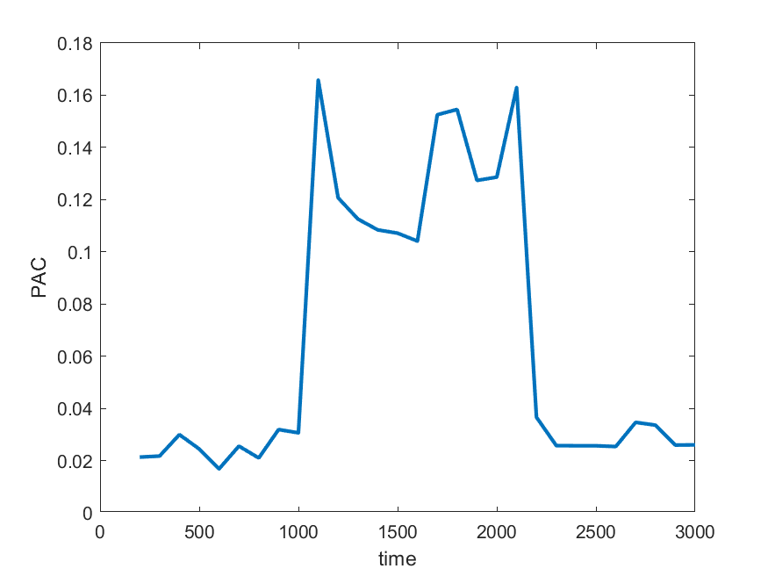
20
24
PAC dynamic
Statistical Analysis:
P-value =
6.0938e-12
03

Slide 28
20
24
Summary
03

Slide 29
20
24
Comodulogram performance
CWT > Old rid-rihaczek > corrected rid-rihaczek > New rid-rihaczek
PAC dynamic performance
CWT > Old rid-rihaczek > New rid-rihaczek > corrected rid-rihaczek
P-value
CWT > Old rid-rihaczek > New rid-rihaczek > corrected rid-rihaczek
03

Slide 30
20
24
Modulation Index
Future
Works
05

Slide 31


